Slide 1

Capstone project - 1
Eda on Hotel Booking Analysis
By
Ansh srivastava

Slide 2
Problem Statement
For this project we will be analyzing Hotel Booking data. This data set contains booking information for a city hotel and a resort hotel, and includes information such as when the booking was made, length of stay, the number of adults, children, and/or babies, and the number of available parking spaces.
Hotel industry is a very volatile industry and the bookings depends on above factors and many more.
The main objective behind this project is to explore and analyze data to discover important factors that govern the bookings and give insights to hotel management ,which can perform various campaigns to boost the business and performance.

Slide 3
Workflow
So we will divide our work flow into following 3 steps.
Data Collection and Understanding
Data Cleaning and Manipulation
Exploratory Data Analysis(EDA)

Slide 4
Data Collection and Understanding
After collecting data it’s very important to understand your data. So we had hotel Booking analysis data. Which had 119390 rows and 32 columns. So let’s understand this 32 columns.
Data Description:
hotel :Resort Hotel or City Hotel
is_canceled : Value indicating if the booking was canceled (1) or not (0)
lead_time : Number of days that elapsed between the entering date of the booking and the arrival date
arrival_date_year : Year of arrival date
arrival_date_month : Month of arrival date
arrival_date_week_number : Week number of year for arrival date
arrival_date_day_of_month : Day of arrival date
stays_in_weekend_nights : Number of weekend nights
stays_in_week_nights : Number of week nights.

Slide 5
Data Collection and Understanding
adults : Number of adults
children : Number of children
babies : Number of babies
meal : Type of meal booked.
country : Country of origin.
market_segment : Market segment designation. (TA/TO)
distribution_channel : Booking distribution channel.(T/A/TO)
is_repeated_guest : is a repeated guest (1) or not (0)
previous_cancellations : Number of previous bookings that were cancelled by the customer prior to the current booking
previous_bookings_not_canceled : Number of previous bookings not cancelled by the customer prior to the current booking
reserved_room_type : Code of room type reserved.

Slide 6
Data Collection and Understanding
assigned_room_type : Code for the type of room assigned to the booking. booking_changes : Number of changes made to the booking from the moment the booking was entered on the PMS until the moment of check-in or cancellation
deposit_type : No Deposit, Non Refund , Refundable.
agent : ID of the travel agency that made the booking
company : ID of the company/entity that made the booking .
days_in_waiting_list : Number of days the booking was in the waiting list before it was confirmed to the customer
customer_type : type of customer. Contract,Group,transient,Transient party.
adr : Average Daily Rate as defined by dividing the sum of all lodging transactions by the total number of staying nights
required_car_parking_spaces : Number of car parking spaces required by the customer
total_of_special_requests : Number of special requests made by the customer (e.g. twin bed or high floor)
reservation_status : Reservation last status

Slide 7
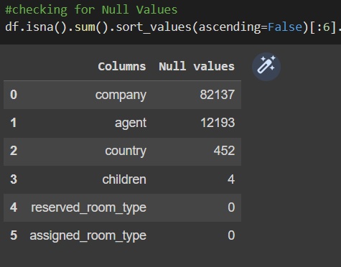
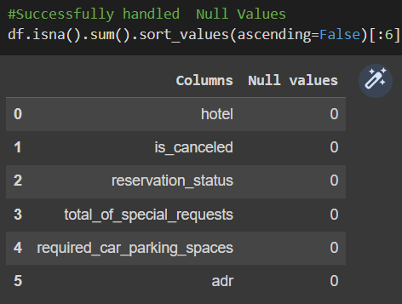
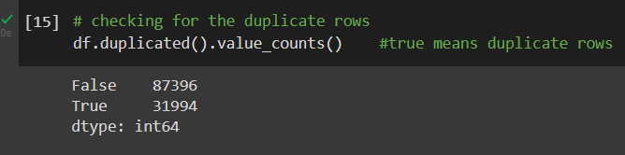
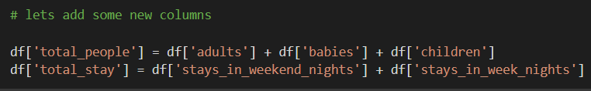
Data Cleaning and Manipulation
There were 4 columns company, agent, country and children with missing values.
Handling Duplicates: Data had 31994 duplicates values. So we dropped it from the data.
We created 2 new columns 1)‘Total_People’ = from the Children, adults, babies.
2) ‘Total_stay’ = From weekend nights and weekdays night

Slide 8
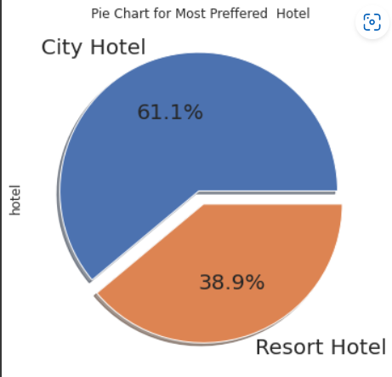
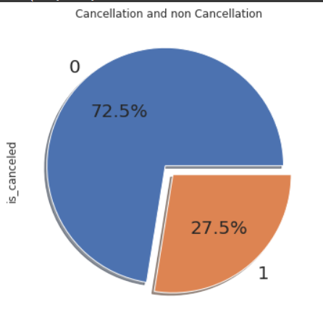
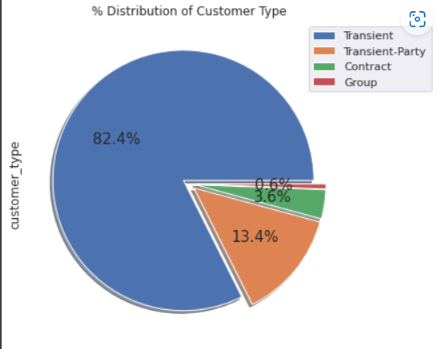
Exploratory Data Analysis (EDA)
Conclusions:
City hotels is the most preferred hotel type by the guests. We can say City hotel is the busiest hotel.
27.5 % bookings were got cancelled out of all the bookings.
Most of the customers/guests were Transient type(82.4%). And transient party were 13.4% and 0.6 belongs to group. Remaining guests belongs to Contract type.
Contract-when the booking has an allotment or other type of contract associated to it
Group -when the booking is associated to a group
Transient-when the booking is not part of a group or contract, and is not associated to other transient booking
Transient-party-when the booking is transient, but is associated to at least other transient bookings.
:

Slide 9
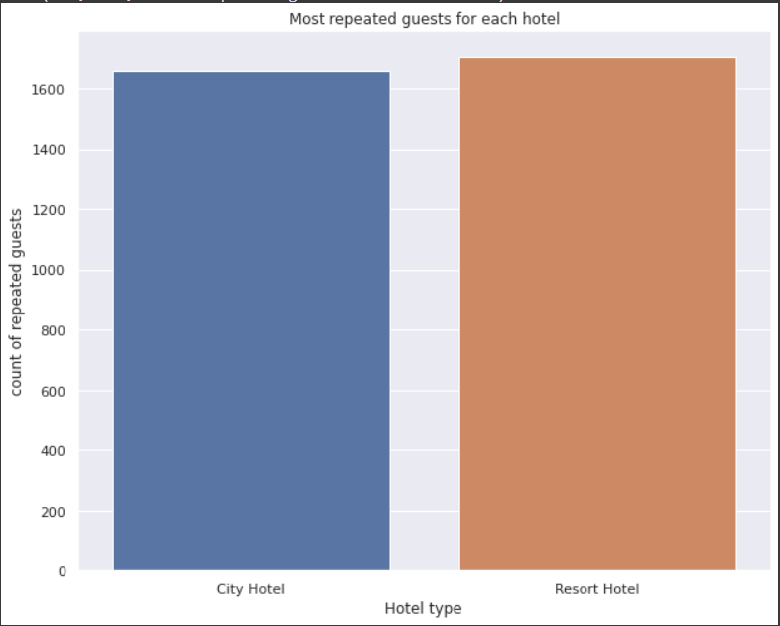
Exploratory Data Analysis (EDA)
Conclusions:
Resort hotels has the most repeated guests. In order to get increase the count of repeated guests hotel management need to take the valuable feedbacks from the guests and try to give good service. Exploratory Data Analysis (EDA)

Slide 10
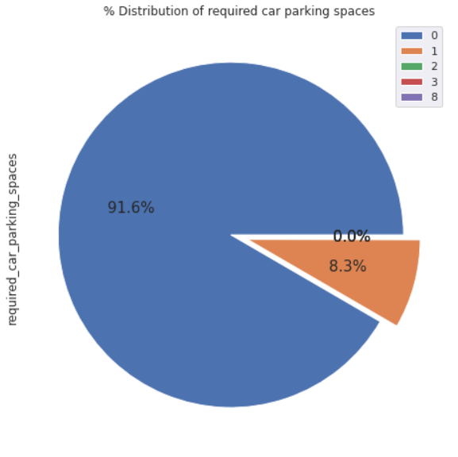
Exploratory Data Analysis (EDA)
Conclusions:
91.6 % guests did not required the parking space. only 8.3 % guests required only 1 parking space.

Slide 11
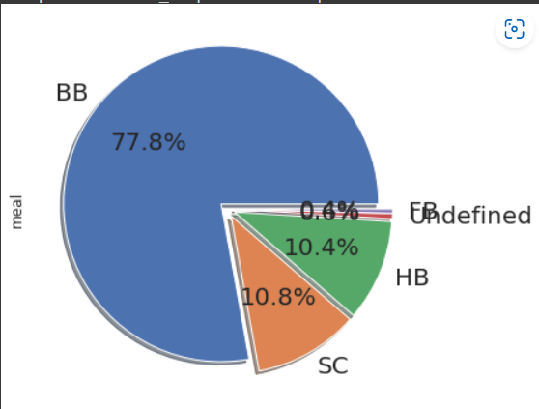
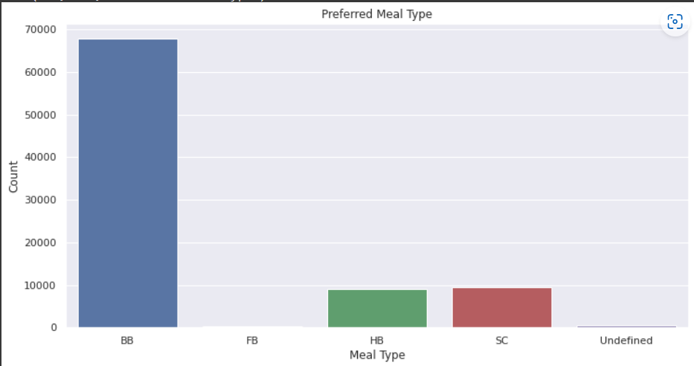
Exploratory Data Analysis (EDA)
Types of meal in hotels:
BB - (Bed and Breakfast)
HB- (Half Board)
FB- (Full Board)
SC- (Self Catering)
So the most preferred meal type by the guests is BB( Bed and Breakfast)
HB- (Half Board) and SC- (Self Catering) are equally preferred.

Slide 12
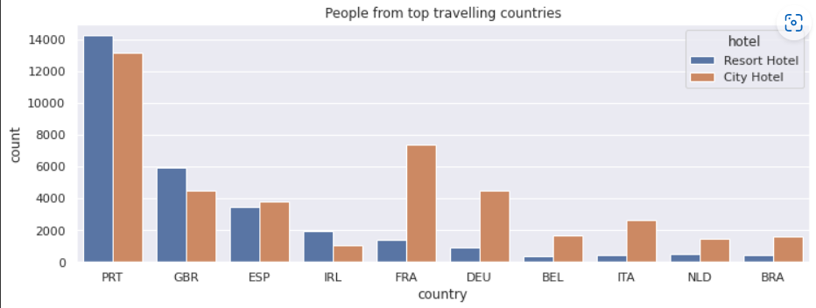
Exploratory Data Analysis (EDA)
PRT- Portugal
GBR- United Kingdom
FRA- France
ESP- Spain
DEU - Germany
ITA -Italy
IRL - Ireland
BEL -Belgium
BRA -Brazil
NLD-Netherlands

Slide 13
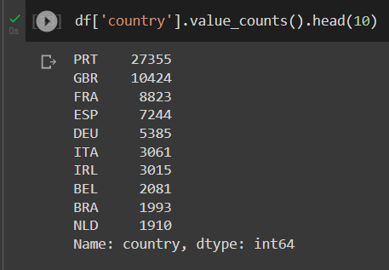
Exploratory Data Analysis (EDA)
Top 10 countries where people booked the hotel’s.
PRT- Portugal
GBR- United Kingdom
FRA- France
ESP- Spain
DEU - Germany
ITA -Italy
IRL - Ireland
BEL -Belgium
BRA -Brazil
NLD-Netherlands

Slide 14
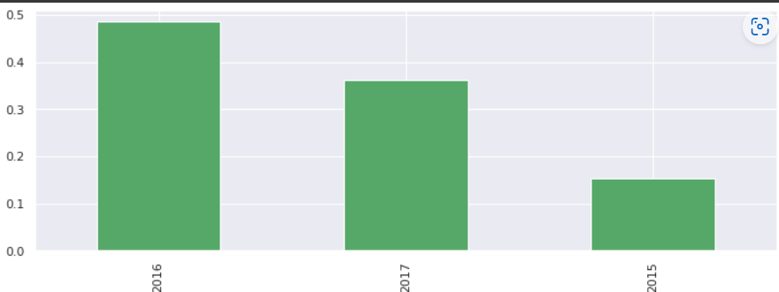
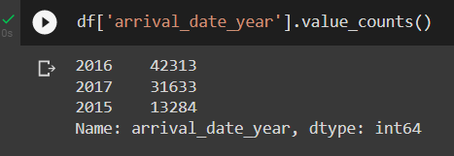
Exploratory Data Analysis (EDA)
2016 had the highest 42313 bookings.
2015 had less 13284 bookings.
2017 had 31633 bookings.

Slide 15
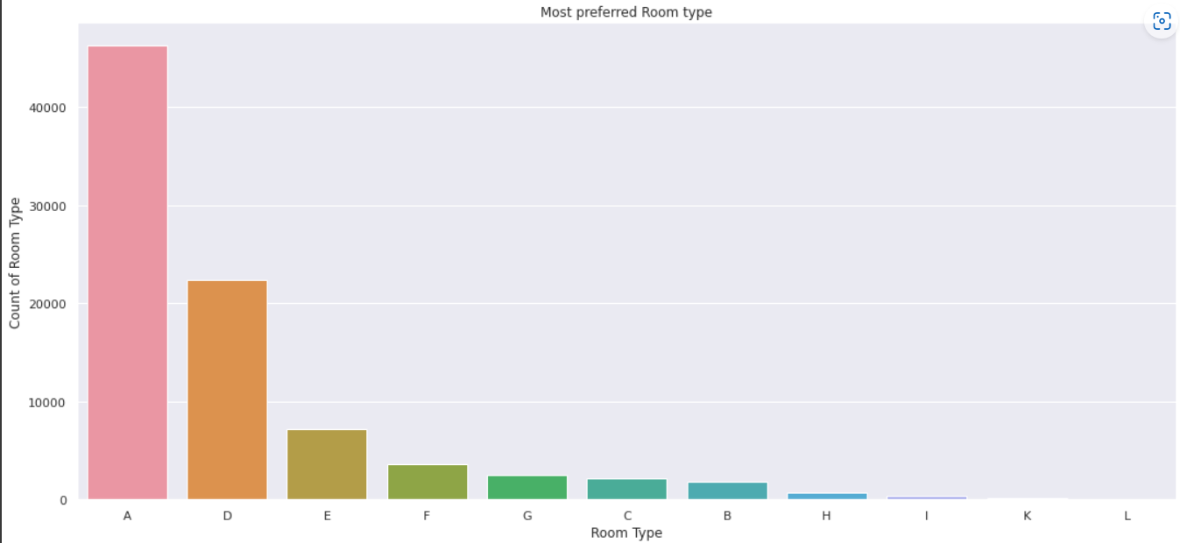
Exploratory Data Analysis (EDA)
So the most preferred Room type is "A"

Slide 16
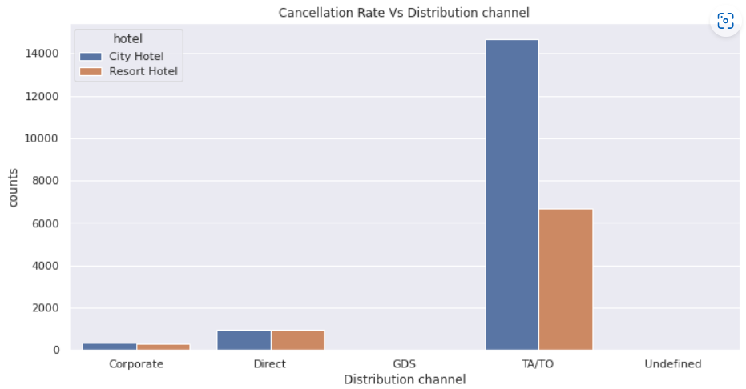
Exploratory Data Analysis (EDA)
Conclusions:
In "TA/TO", City hotels has the high cancellation rate compared to resort hotels.
In "direct" both the hotels has almost same cancellation rate.

Slide 17
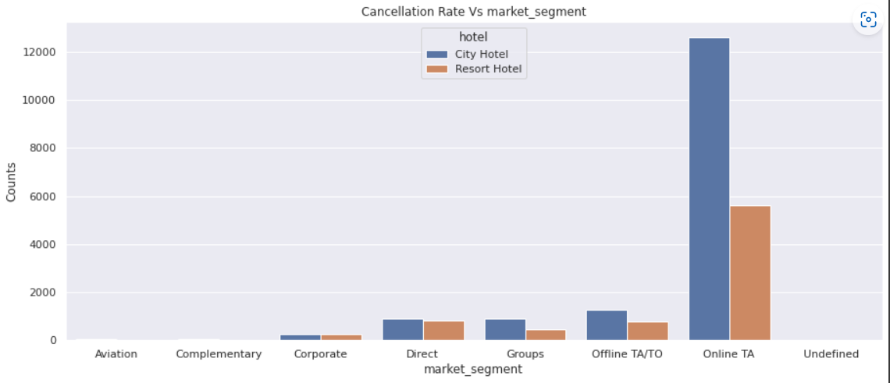
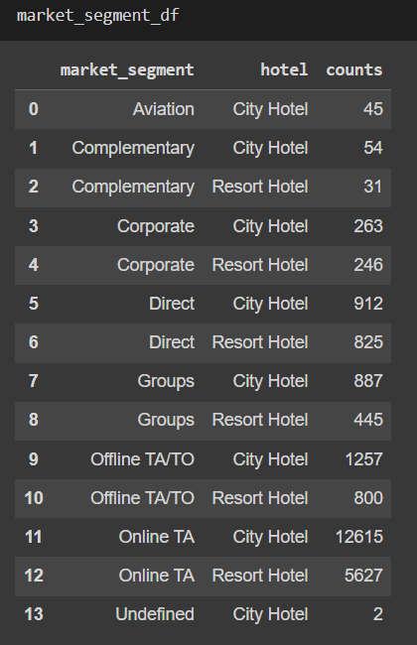
Exploratory Data Analysis (EDA)
Market Segment:
‘Online TA/TO’ market segment has highest cancellations for city hotels

Slide 18
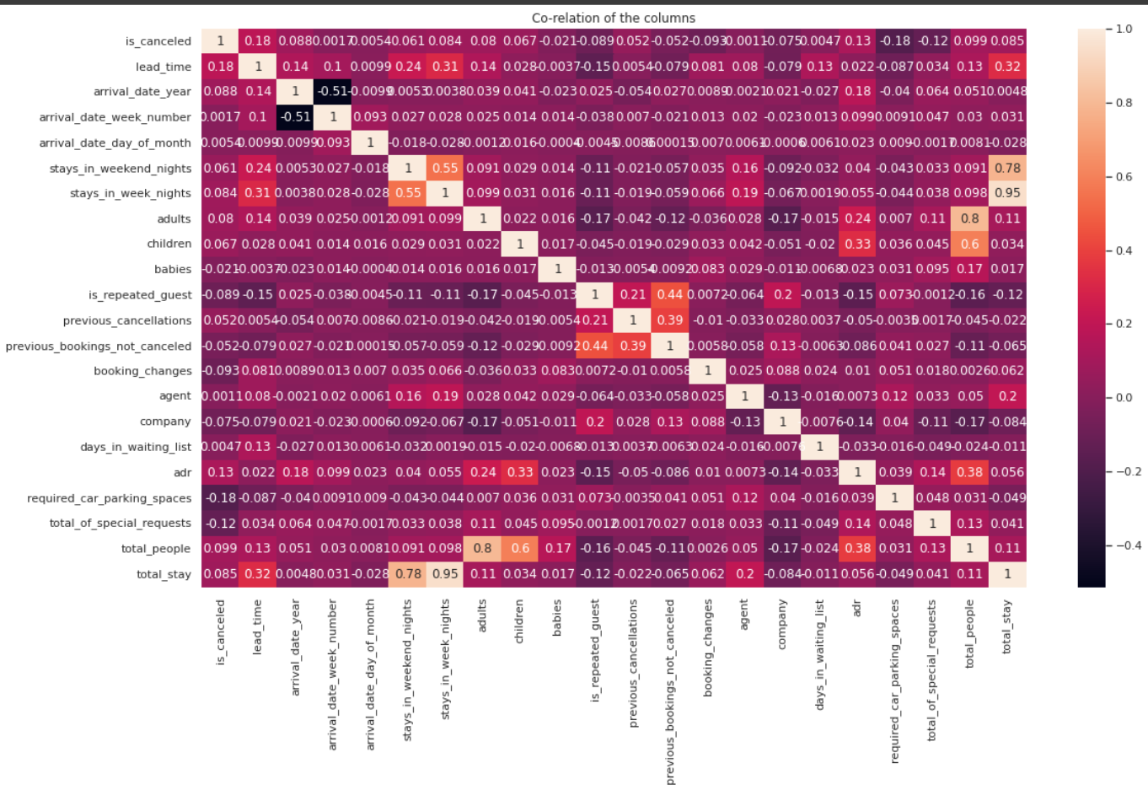
Exploratory Data Analysis (EDA)
Conclusions:
is canceled and same_room_alloted_or_not are negatively correlated. Not getting the same room as per reserved room is not the reason for booking cancellations.
lead-time and total stay is positively correlated means more is the stay of customer more will be the lead time.
ADR and total people are highly correlated. That means more the people more will be adr.High adr means high revenue
is_repeated_guest and previous_bookings Not_canceled has strong correlation. May be repeated guests are not more likely to cancel their bookings.

Slide 19
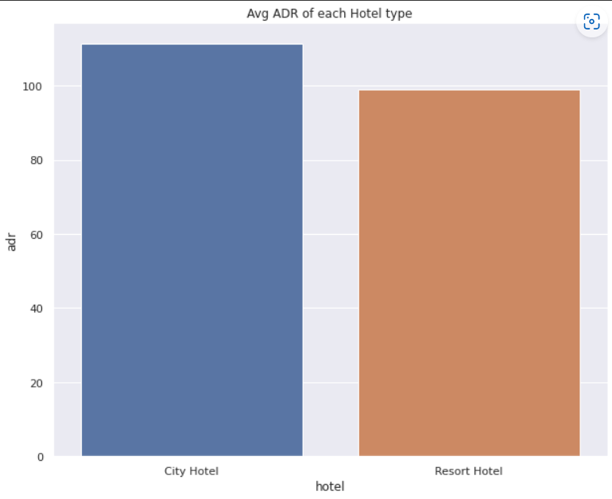
Exploratory Data Analysis (EDA)
City hotel has the highest ADR. That means city hotels are generating more revenues than the resort hotels. More the ADR more is the revenue.

Slide 20
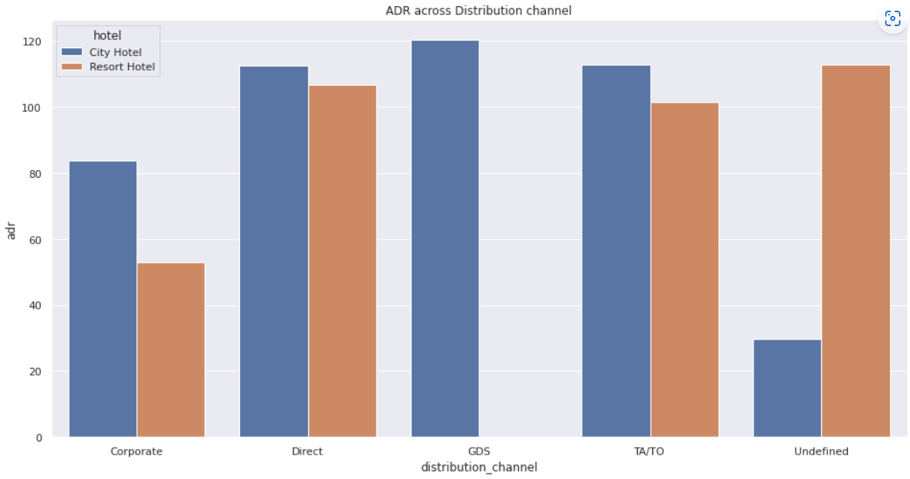
Exploratory Data Analysis (EDA)
Corporate- These are corporate hotel booking companies which makes bookings possible.
GDS-A GDS is a worldwide conduit between travel bookers and suppliers, such as hotels and other accommodation providers. It communicates live product, price and availability data to travel agents and online booking engines, and allows for automated transactions.
Direct- means that bookings are directly made with the respective hotels
TA/TO- means that booings are made through travel agents or travel operators.
Undefined- Bookings are undefined. may be customers made their bookings on arrival

Slide 21
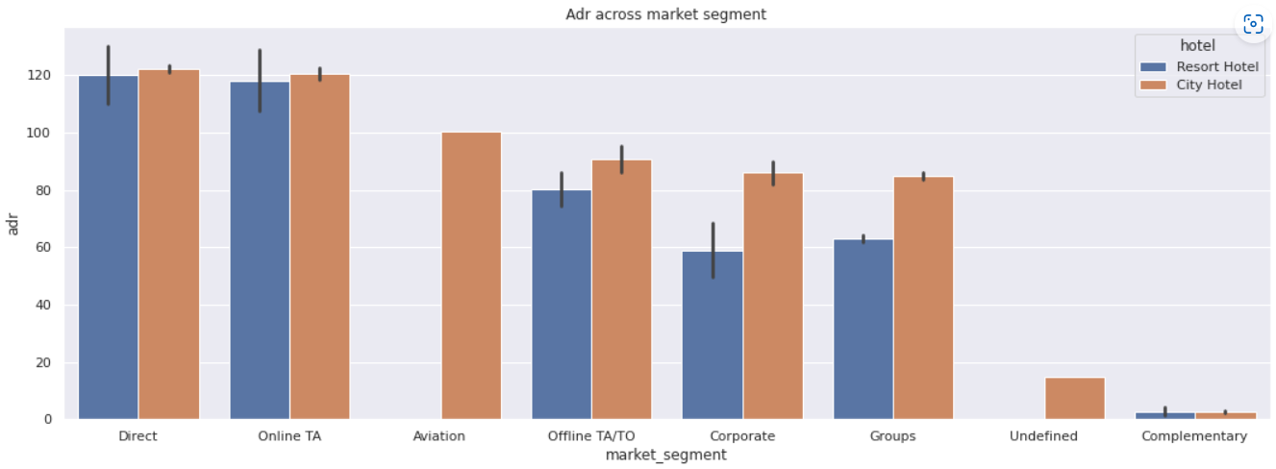
Exploratory Data Analysis (EDA)
Direct' and 'Online TA' are contributing the most in both types of hotels.
Aviation segment should focus on increasing the bookings of 'City Hotel'

Slide 22
THANK YOU!!

